Slide 1
Theories of international trade
Mercantilist approach to international trade
Absolute cost advantage principle
Comparative cost advantage principle
Heckscher Ohlin theory of factor endowment
Technological gap or imitation theory
Product life cycle theory
Intra industry trade theory
The above theories would help us understand the emergence of international trade and the benefits that can be derived from international trade.

Slide 2
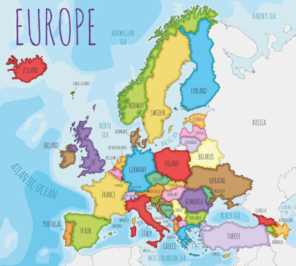
Mercantilist approach to international trade
This topics takes us back to 1500 and 1800 led to the emergence of Mercantilist.
Where Holland, France, Spain and England
Countries wanted to export more than import

Slide 3
Mercantilism strongly advocated govt regulations and interventions in international trade to achieve a surplus on balance of trade in order to accumulate precious metals.
And countries seen as increasing national wealth and prestige.
Mercantilism worked hand-in-hand with the gold standards.

Slide 4
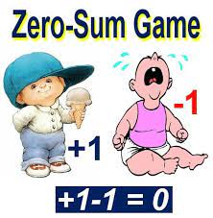
To maximize exports and minimize imports
To achieve this, artificial barriers like tariffs and quota were enforced on imports while exports were subsidized.
However mercantile failed to understand that it is impossible for all the countries to achieve surplus on balance of trade simultaneously.
Mercantilist is a philosophy of Zero sum game ( its one’s gain only at the cost of other)

Slide 5
David Hume in his doctrine, stated the favorable trade surplus is a short run phenomenon and it would be eliminated in the long run.
The increase in trade leads to increase in money supply which results in cost push inflation thus making export expensive and imports cheaper.
On the other hand, the country having a trade deficit experiences a fall in prices and wages resulting into lower cost of production, thus increasing exports and reducing imports.
The entire phenomenon helps in restoring equilibrium in international trade.

Slide 6
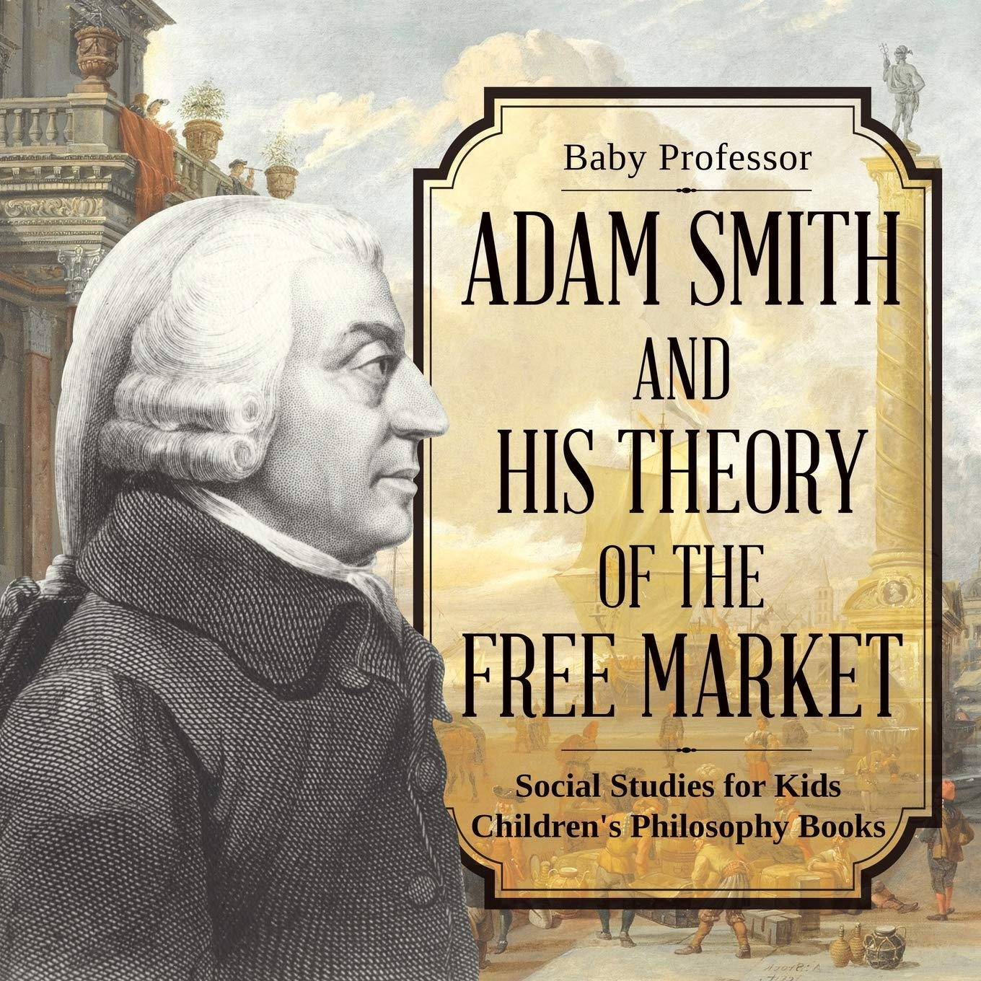
2nd Theory: Absolute cost advantage principle
Under Mercantilist- trade benefits only to exporting nation.
Adam smith through his Absolute cost advantage principle advocated ‘FREE TRADE’ which benefit exporting as well as importing nation also.
Smith considers domestic cost of production as the basis of international trade.
According to his principle, a country should specialize in the production and export of goods which could be produced at a lower cost.
And import the goods which are domestically produced at a higher cost.

Slide 7
Country should export the goods of its absolute cost advantage and import goods which are absolute cost disadvantage.
Principle based on the concept of positive sum game, in which every participant benefits.
According to smith, specialization in production and export of goods of absolute advantage will promote division of labor and brings out optimum allocation of productive resources of the world.

Slide 8
Production of One Unit of labor/day
Example of 2x2x1 (two goods, two nation, one labor)
In the absence of trade, using two labours available, Portugal produces 25 units of wine & 10 units of cloth in a day. England produces 10 units of wine & 15 units of cloth
So the world total production of wine is 35 units and cloth is 25 units per day.
Goods | Portugal | England
Wine | 25 | 10
Cloth | 10 | 15

Slide 9
If they follow the absolute cost advantage and resort to free trade of two commodities, both nation will benefits and resources used optimally.
If Portugal/ England specializes in the production of wine / cloth (absolute cost advantage goods) and exports the same to England/ Portugal and import cloth wine (absolute cost disadvantage goods). Then the situation will be
Production of one unit of labour/ day
Goods | Portugal | England
Wine | 50 | 0
cloth | 0 | 30

Slide 10
Above table clearly supports smith’s principle of absolute cost advantage, it clearly shows us that free trade leads to production and specialization of absolute cost advantage goods by respective nations.
This results in increasing production of wine by 15 units and cloth by 5 units.
We conclude that the world as a whole benefits more from free trade as compared to restrictive trade suggested by mercantilists.

Slide 11
Last theory Comparative cost advantage principle
Well absolute cost advantage support free trade and thereby leads to optimum allocation of resources
But it was unable to explain the possibility of international trade in case wherein a particular country enjoys absolute cost advantage in both the commodities due to various reasons
Such as availability of cost effective labour, abundant natural resources or highly advanced technology.

Slide 12
The possibility of mutually beneficial trade even in such circumstances was explained by David Ricardo in 1817 though his theory of comparative cost advantage in his book ‘the principles of Political economy and taxation’
Labor cost structure/ unit of goods
Goods | Portugal | England
Wine | 80 | 120
Cloth | 90 | 100

Slide 13
The absolute cost of producing both wine and cloth is lower in Portugal than in England.
But the application of comparative cost advantage principle will help us to know that wine is produced at a comparatively lower cost in Portugal, while cloth comparatively cheaper in England.

Slide 14
Portugal domestic cost ratio for wine and cloth
1 unit of wine = 0.89 units of cloth (80/90) whereas,
1 unit of cloth = 1.13 units of wine (90/80)
England domestic cost ratio for wine and cloth
1 unit of wine = 1.2 units of cloth (120/100) whereas,
1 unit of cloth= 0.83 units of wine (100/120)

Slide 15
The above domestic cost ratios of the two nations will help us prove the comparative cost advantage principle of ricardo.
If both nations agree to trade at a ratio of 1 unit of wine for 1 unit of cloth then, gain for Portugal over domestic production is 0.11 unit of cloth (1-0.89), while gain for England is 0.17 units of wine (1-0.83).

Slide 16
Heckscher- Ohlin’s factor endowment theorem
The question asked is why should some countries have comparative advantage in some products and disadvantaged in other products.
This was explained by modern theory of trade given by Heckscher ohilin.
Comparative cost differences do not show why cost differences arises but modern theory says it arises because of relative factor endowment.
The basic determinant of trade is price differentials and not cost differentials. Price differences caused for different reasons and one could be cost differences.

Slide 17
A product can be sold abroad only if it is cheaper than their domestic product.
Difference in cost of production caused by relative abundance and scarcity of factors of production.
So the ratio of factor proportions would determine the abundant and scarce factors in every nation.
If capital labour ratio is higher then it would be a capital abundant nation but if capital labour ratio is lower then it would be labour abundant nation.

Slide 18
The cost of abundant factors would be lower and that of scarce factors would be higher.
In case india, where labour is abundant and capital is scarce, wages will be low and interest will be high.
In USA?
The abundance or scarcity of labor determines the factor prices.

Slide 19
The factor price differences are converted into product price because of two fundamental positions:
So according to theorem countries should specialize in production of those goods which uses more of abundant factors and less of its scarce factors which are expensive.
So scarce countries should import product from abundant countries.
Accordingly, india should export? And import?

Slide 20
5th theory: Technological Gap or Imitation Gap
Earlier theories (last 2) failed to analyse and explain the role of technological innovations or advancement in international trade.
Theory given by M.V. Posner in 1961.
According to Posner, when a country introduces a new product in the market as a result of technological advancement, it leads to the imitation and demand gap in the other country.
The net effect of imitation and demand gap would determine the magnitude of trade between the two countries.

Slide 21
Theory assumes there exist similar factor endowments, demand conditions, and pre trade factor price ratio but different level of technological progress.
Theory believes that whenever a firm introduces a new product in domestic market due to technological advancement, it attains a sort of monopoly power.
Then export begins once it accepted in domestic market.
The high profit of the innovating firm motivates the firms in the importing nations to imitate the product.
Export remains continue until importing nation firms fully learn the art of imitation and start producing the same product.

Slide 22
So the technology gap or imitation gap is nothing but it’s the time period taken by firms in importing nations to learn the technique and technology required to produce the product which was innovated by the exporting country.

Slide 23
Technology gap theory includes three stages
Foreign reaction lag
Refers to the time taken by the innovating firm to start the production of a new product
2. Domestic reaction lag
Is the time taken by other domestic producers to learn the technique of production in the domestic market.

Slide 24
3. Learning period
Defines the time taken by domestic producers to master the production process and for selling the new product in the domestic market
4. Demand lag
Which is time taken by consumers in the importing country to acquire the test of a new product.

Slide 25
The extent of demand lag would determine the duration of the imitation or technological gap.
If consumers in the importing country adopt a new product very quickly but the producers take long time to imitate the production process of a new product then the imitation gap would be long and vice versa.
Thus, the export and import of a new product between the two countries will depend on the relative strength of imitation and demand gap

Slide 26
^{6th} Theory: product life cycle theory
Raymond Vernon of the Harvard Business School advocated this theory in 1960.
Theory helped to explain the reasons behind the existence of international trade and foreign direct investment FDI.
Theory considers as an extension of the Technological gap theorem put forward by Posner
Theory seeks to explain the process in which a country which is initially an exporter of a product eventually undertakes FDI in a country that can produce a product at a lower cost and finally becomes importer of the same product.

Slide 27
Raymond stresses on information, uncertainty and economies of scale rather than on comparative cost.
The product life cycle theory proposes that certain technologically advanced countries undertake the invention and production of new products while remaining countries tend to supply well established or existing product in the world market.
As per theory each product passes through 3 stages in its life cycle:
New product stage
Maturing product stage
Standardized product stage

Slide 28
New product stage
This is initial stage, firm introduces new product into domestic market. Qty produce is limited as consumer responses is unknown. No exports.
2. Maturing product stage
Marked by increase in production, demand increases in national and international mkt. the innovating country dominates international mkt in the second stage. Firm sets up manufacturing units abroad. By the end of this stage the product is well established in the mkt.

Slide 29
3. Standardized product stage
Last stage of product life cycle. The demand for product is stabilized and the market become price sensitive. The innovating firm tries to transfer the technology and production facility into a low cost producing economy to bring down cost of production.
Mostly during this stage, the innovating country starts importing the product and almost wraps up domestic production.

Slide 30
Last theory 7th one: Intra Industry trade theory
Refers to the exchange of commodities of different industries for each other.
It refers to a trade of differentiated products within the same industry.
Differentiated products are similar but not identical.
Intra industry trade usually takes place when a country does not experience a huge cost differences in all the varieties of different products within an industry.
For instance, a country may enjoy cost advantage in small and economical car segment but not in big and luxury cars.

Slide 31
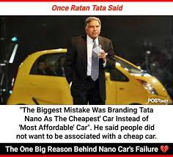
Under intra industry trade the exporter many a times caters to a ‘Niche Market’. It is a small size market in an importing country which is not catered to by domestic suppliers as they are concentrating on demand preference of majority consumers.
For example Japan export small cars to USA as the domestic suppliers more engaged in catering to consumer preferring large size class.
Intra trade industry provides a wide ranges of choices to consumers at reduced prices, exports enable them to increase the scale of production and help producers benefit from economies of scale.

