Slide 1
PRICING
Pricing Strategies and Methods

Slide 2
Cost Based Pricing
Cost-based pricing is the act of pricing based on what it costs a company to make a product.
Cost Plus Pricing Method
Target Rate of Return Pricing Method
Marginal Cost Pricing Method

Slide 3
Cost Plus / Full Cost Pricing
Commonly adopted method where cost of production is determined and a margin/profit is added to arrive at the final price
Cost Plus Price = Cost + Fair profit (AC + Mark-up Profit)
Cost ( Actual, Expected or Standard)
Fair profit ( A fixed % of profit mark-up, arbitrarily determined, differs from industry to industry)
Shortcomings (ignores - consumer preference and demand, effect of competition, fails to consider incremental costs, over stresses on precision of allocated costs)

Slide 4
Target Rate of Return Pricing Method
Price is determined along a planned rate of return on investment.
An improved version of cost-plus pricing method.
The minimum Rate of return is decided by the producer rationally based on the firm’s past experience.
Rate of return has to be converted into per cent mark-up as profit margin on cost.
Mark-up Profit Margin = C x R
( Capital Turnover x Targeted rate of return)
Capital Turnover = Invested Capital / Annual Standard Cost

Slide 5
Marginal Cost Pricing Method
Marginal cost pricing is the practice of setting the price of a product g at or slightly above the variable cost/marginal cost to produce it.
This situation usually arises in one of two circumstances:
A company has a small amount of remaining unused production capacity available that it wishes to use; or
A company is unable to sell at a higher price
Advantages (allows to earn from un/under- utilized capacity, adds profits, market entrance, accessory sales, public utility, effective in fiercely competitive markets)
Disadvantages (ignores TFC & ineffective in long-run, ignores market prices)

Slide 6
Competition Based Pricing
A pricing method in which:
’a seller uses prices of competing products as a benchmark instead of considering own costs or the customer demand.’
Penetration Pricing
Entry Deterring Pricing and
Going Rate Pricing

Slide 7
Penetration Pricing
Penetration pricing is a pricing strategy where the price of a product is initially set at a price lower than the eventual market price, to attract new customers.
Works towards the objective of increasing market share or sales volume, rather than to make profit in the short term.
Price penetration is most appropriate where:
Product demand is highly price elastic.
Substantial economies of scale are available.
The product is suitable for a mass market (i.e. enough demand).
The product will face stiff competition soon after introduction.

Slide 8
Penetration Pricing
Advantages
Results in fast diffusion and adoption.
It can create goodwill among the early adopters segment. This can create more trade through word of mouth.
It creates cost control and cost reduction pressures from the start, leading to greater efficiency.
It discourages the entry of competitors. Low prices act as a barrier to entry.
It can create high stock turnover throughout the distribution channel. This can create critically important enthusiasm and support in the channel.
It can be based on marginal cost pricing, which is economically efficient.

Slide 9
Penetration Pricing
Disadvantages
It establishes long term price expectations for the product, and image preconceptions for the brand and company.
May attract only the switchers (bargain hunters), and they will switch away as soon as the price rises.
Low profit margins may not be sustainable long enough for the strategy to be effective.

Slide 10
Entry Deterring Pricing
Similar to Limit or Predatory pricing
It is a pricing strategy where a product or service is set at a very low price, intending to drive competitors out of the market, or create barriers to entry for potential new competitors.
It is used by monopolists to discourage entry into a market, and is illegal in many countries.
Obviously, predatory pricing pays off only if the surviving predator can then raise prices enough to recover the previous losses, making enough extra profit thereafter to justify the risks.

Slide 11
Going Rate Pricing
Going rate pricing is a pricing strategy where firms examine the prices of their competitors and then set their own prices broadly in line with these.
It is a competitive pricing method under which a firm tries to keep its price at the average level charged by the industry.

Slide 12
Going Rate Pricing
Going rate pricing is most likely to occur where:
it is difficult to measure costs.
there is a degree of price leadership taking place within a particular market
businesses are reluctant to set significantly different prices because of the risk of setting off a price war, which would reduce profits to all firms
there is a degree of collusion taking place between firms

Slide 13
Product Life Cycle based pricing
The Product Life Cycle (PLC) is used to map the lifespan of a product. There are generally four stages in the life of a product. These four stages are the Introduction stage, the Growth stage, the Maturity stage and the Decline stage.

Slide 14
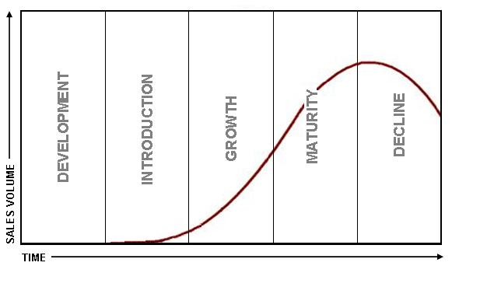
PLC 1

Slide 15
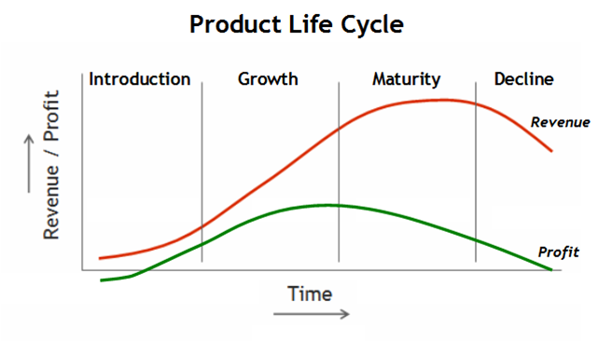
PLC 2

Slide 16
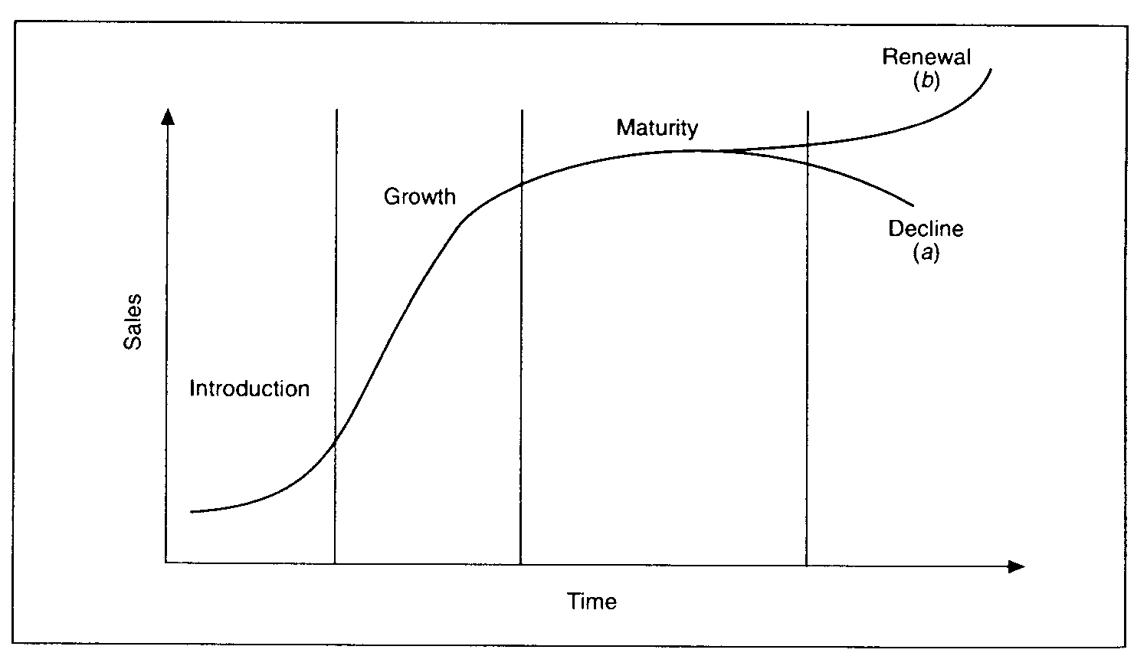
PLC 3

Slide 17
Price Skimming
Very high price in the beginning (skim the market) – Introduction stage ( targeting consumers with low Ep)
Earn super margins with high mark-up on sales
Reduce profit margins and lower price as the product approaches maturity. ( Informed consumers and higher competition – targeting consumers with high Ep)
This is price discrimination of first degree

Slide 18
Product Bundling or Packaging
Two or more products bundled together for single price
Introduction stage – promote a new product
Growth and Maturity – expansion of sales, competition
Decline – clear inventory
Hotels, Airlines, 3 shirts for 999/-

Slide 19
Perceived Value or Psychological Pricing
Value of goods for different consumers depends upon their perception of utility of the good.
Consumer’s willingness to pay reflects the value the product to him
Branding, higher price – better quality
Hype about quality
Normally adopted during growth & maturity
Product differentiation through pricing
No necessary link between price and cost of production.

Slide 20
Value pricing
Variant of perceived value pricing
Price should represent value for money
High price tag to create brand perception
Price charged < Perceived value of product
Consumer is allowed to enjoy some consumer surplus
Suitable strategy for maturity and saturation stage.

Slide 21
Loss Leader Pricing
Multi-product firm – sell one product at low price & compensate the loss ( on margin not cost of production) by other products.
Success of this strategy depends upon combination of goods – complimentary nature
Also used by retailers as an effective marketing strategy.

Slide 22
Strategies in the Declining Stage
Retrenchment
Harvesting
Consolidation

Slide 23
Retrenchment
Typically the strategy involves withdrawing from certain markets or the discontinuation of selling certain products or services in order to make a beneficial turn around.
This strategy is often used to cut down expenses with the goal of becoming more financially stable business.

Slide 24
Harvesting
Planned discontinuation of a product at the end of its life cycle, while extracting maximum profit from its sales. In this strategy, all marketing expenditure is gradually eliminated and the product is allowed to sell on its goodwill until sales revenue falls below a cutoff point.
A harvest strategy is employed when a line of business is considered to be a cash cow, meaning that the brand is mature and is unlikely to grow if more investment is added. The company will instead siphon off the revenue that the cash cow brings in until the brand is no longer profitable.

Slide 25
Consolidation
Consolidation strategy is an attempt to gain a stronger position in a declining industry.
It is viable only for a firm that begins the decline in strong financial position, enabling it to weather the storm that forces its competitors to flee.
A successful consolidation leaves a firm in a position to make profits after a shakeout with a larger market share in a restructured less competitive industry.

Slide 26
CYCLICAL PRICING
Dynamic nature of the economy – economic & business cycles
Global integration & interdependence
Pricing w.r.t phases of business cycles (prosperity, recession, depression, recovery, prosperity)
Two approaches – rigid pricing & flexible pricing

Slide 27
Rigid Pricing
This approach focuses on Stable pricing irrespective of phases of economic cycle.
postponement of consumption may make price changes irrelevant
More relevant to consumer durables but also in case of non-durables (food) price changes may not be effective

Slide 28
Flexible pricing
Approach focuses on flexible prices responding to changing demand
More relevant to FMCG
Low prices during recessionary trends help in inducing demand and may restrict further fall
Higher prices in prosperity or expansion phase will allow better earnings (especially agro products due to less elastic supply)

Slide 29
PEAK LOAD PRICING
Price discrimination based on time segments
Time zone division – peak load & off peak load
Peak load – higher price
Off peak load – lower price, discounts
Also includes off season & peak season pricing

Slide 30
Sealed Bid Pricing
Absence of open market pricing
Monopsony (buyers market)
Suppliers provide selling rates in sealed form – Tenders (Government)
Bidding - Lowest bid gets the contract
Constraints of low pricing and execution of contracts

Slide 31
Administered Pricing
Statutory in nature – determined by Govt.
Social welfare – dual pricing (fair price shops)
Aim at equity, price stability and efficient allocation of resources
Ignores cost of production and operations
Can lead to heavy accumulation of losses
May also gives rise to black marketing and unethical trade practices.

Slide 32
Export Pricing and Dumping
International trade relevance & significance
Exports and Imports
Pricing methods may be similar but export pricing has its own challenges
Pricing challenges – unpredictability of foreign markets, Forex issues – multiple currencies, fluctuating rates,
Effective export Pricing depends on thorough understanding of foreign mkt conditions, trade restrictions, tariffs, duties, govt. policies

Slide 33
Dumping
International price discrimination – paying capacity and Ep
Dumping – form of intl. price discrimination strategy
Dumping – bulk exports to foreign markets at price lower than domestic market or even lower than MC of production.
Gaining monopoly, clearing excess inventory
Anti-dumping duties

Slide 34
Multi-Product Pricing
Types:
A joint Product Firm (main product + by-product) (soap + glycerine, sugar + molasses, agro and dairy)
Extension of product line to several related products ( garments, shoes – diff sizes, colors)
Product line with unrelated products – (Tata tea, steel, software, salt, soap)

Slide 35
Multi-Product Pricing
Demand Relationship – (substitutes or complements – depends on Ec)
Cost relationship – (in case of same prod. facilities – directly chargeable vs common costs)
Production relationships – single production process – primary product with one or more by-product
Capacity relationship – excess or idle capacity used to produce one or more additional products alters optimal Q and P for all products.

