Slide 1
Economic Efficiency and Markets

Slide 2
Economic Efficiency and Markets:
Economic efficiency is defined as a state where every resource is allocated optimally so that each person is served in the best possible way and waste are minimized.
Conditions for attaining Economic efficiency:
All users achieve the same marginal benefit.
All suppliers operate at the same marginal cost.
Every users marginal benefit is equal to every suppliers marginal cost.
Amount of production of a product should be in a point where marginal cost and marginal utility are same.
Fixed amount of commodity must be produced at a minimum cost.
Barriers to global trade are removed.

Slide 3
Relation between Markets and Economic efficiency:
Economic efficiency is the theoretical point where all resources are being used in the best interest of society.
If an economy is operating at capacity, an increase in the production of one good or service, say Good Y, must result in a trade of and a drop in the production of another good or service, say Good X.
The concept of economic efficiency can be explained with the help of Production Possibility Frontier.
On the frontier, the country fully utilizes its resources.
It is impossible to increase the production of X without reducing the production of Y.

Slide 4
Write explanation for the above figure.

Slide 5
Types of Economic Efficiency:
Economic efficiency is concerned with the optimal production and distribution of the scarce resources and may be classified into:
Productive Efficiency
Allocative Efficiency
Technical Efficiency
X Efficiency
Scale Efficiency
Dynamic Efficiency

Slide 6
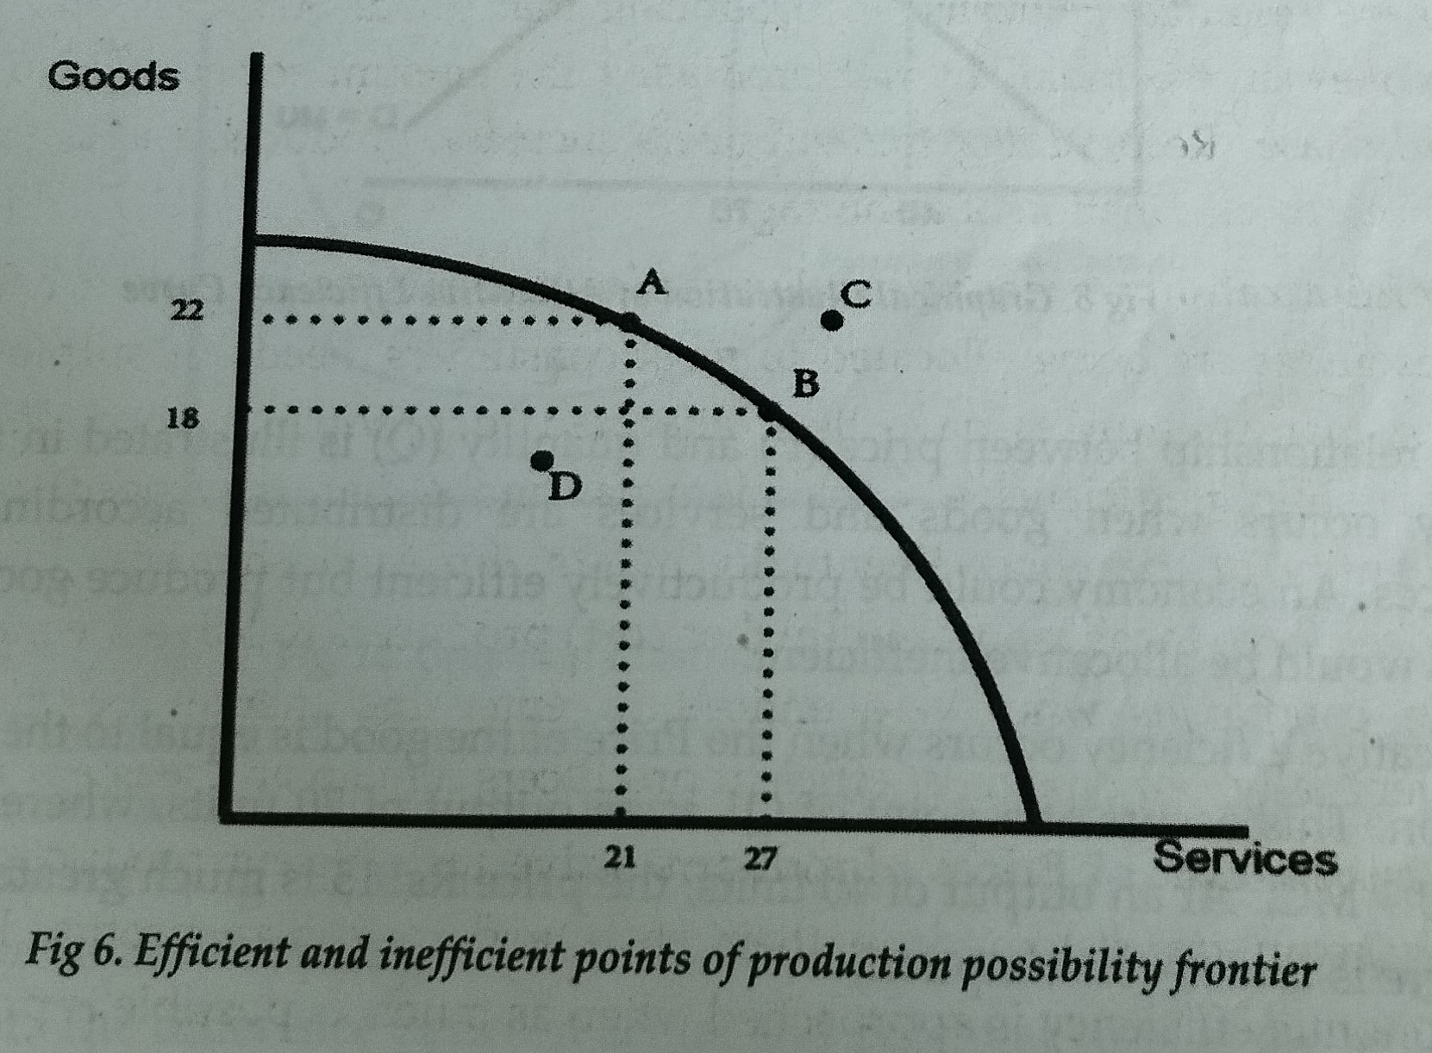
1. Productive Efficiency:
Productive efficiency is concerned with producing goods and services with the optimal combination of inputs to produce maximum output for the minimum cost.
Productively efficient means the economy must be producing on its PPF, i.e. it is impossible to produce more of one good without producing less of another.

Slide 7
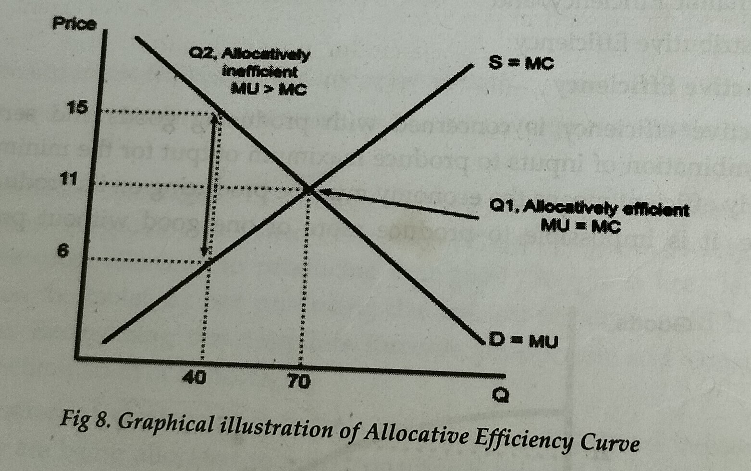
2. Allocative efficiency:
Allocative efficiency occurs when goods and services are distributed according to consumers preferences.
An economy could be productively efficient but produce goods people don’t need this would be allocative inefficient.
Allocative efficiency occurs when the price of the good is equal to the marginal cost of production.

Slide 8
3. Technical Efficiency:
Technical efficiency is the effectiveness with which a given set of inputs is used to produce an output. A firm is said to be technically efficient if a firm is producing the maximum output from the minimum quantity of inputs, such as labour, capital and technology.
Technical efficiency is achieved when we produce the maximum output possible.
Technical Efficiency= Actual output from given inputs x 100
Max. potential output from given inputs
Example: Suppose a firm produces 300 guns a week from its current workforce and quantity of machines and if the maximum potential output was 320, the technical efficiency rate would be: 93.75%.

Slide 10
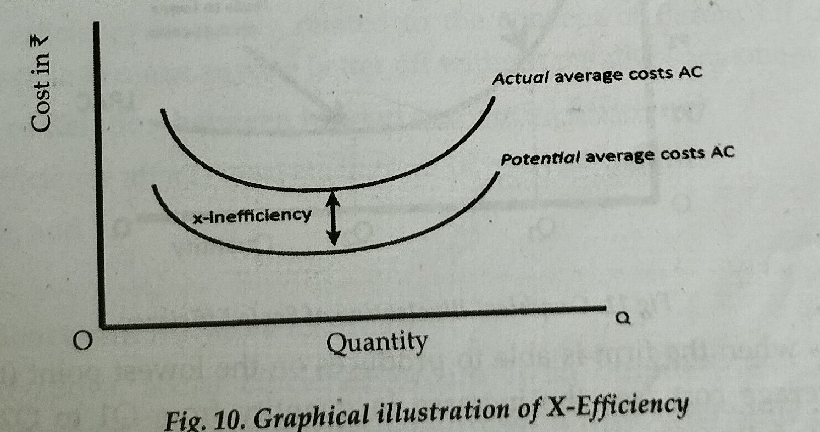
4. X Efficiency:
This occurs when firms do not have incentives to cut costs, for example, a monopoly which makes supernormal profits may have little incentive to get rid of surplus labour.
If a firms average costs are higher than potential then we are x-inefficient. The firm could have an average cost curve at “Potential AC” but due to organizational slack, its actual average costs are higher.
The difference between actual and potential costs is the X-inefficiency.
X-Efficiency would occur when competitive pressures cause firms to combine the optimum combination of factors of production and produce on the lowest possible average cost curves.

Slide 11
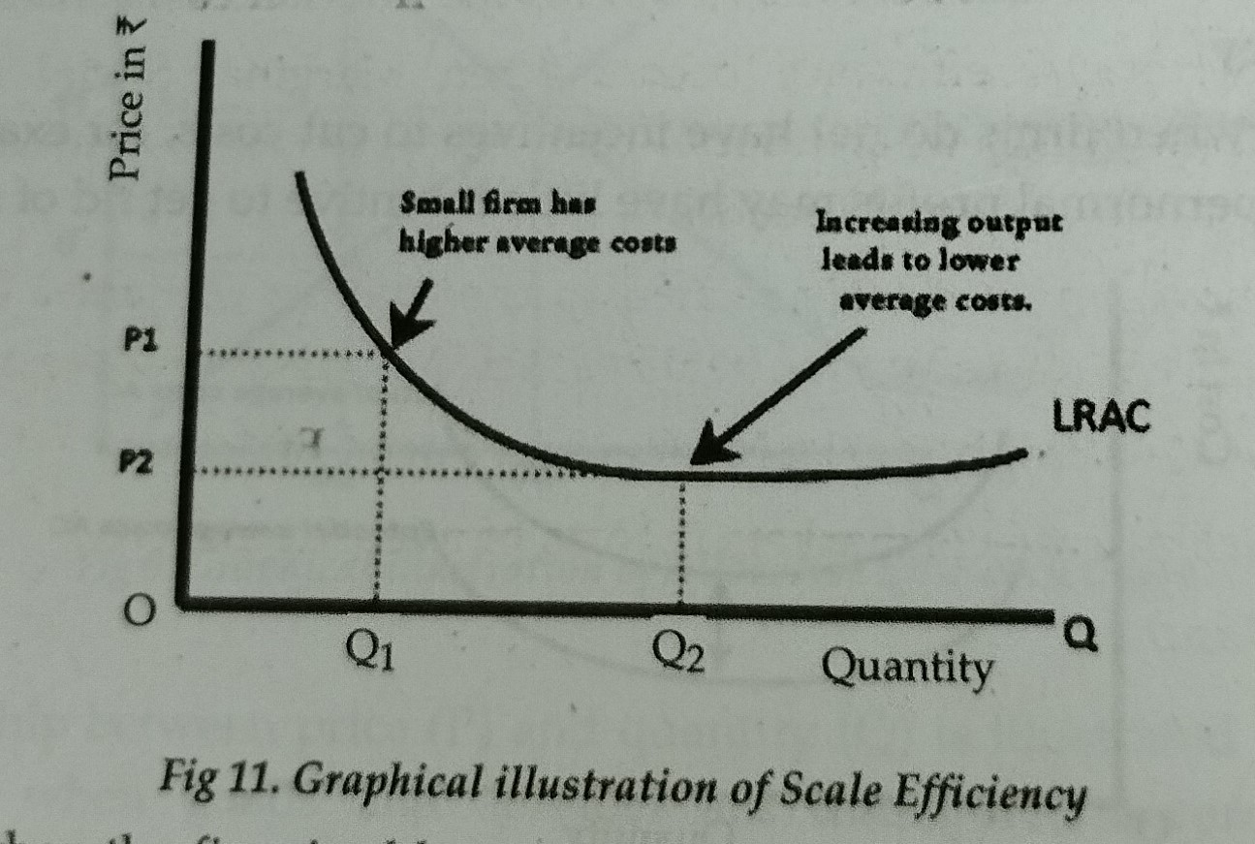
5. Scale Efficiency:
Economies of scale are important because they mean that as firms increase in size, they can become more efficient.
For certain industries, with significant economies of scale, it is important to be a large firm, otherwise they will be inefficient.
This occurs when firm is able to produce on the lowest point of its long-run average cost and therefore benefits fully from economies of scale.

Slide 12
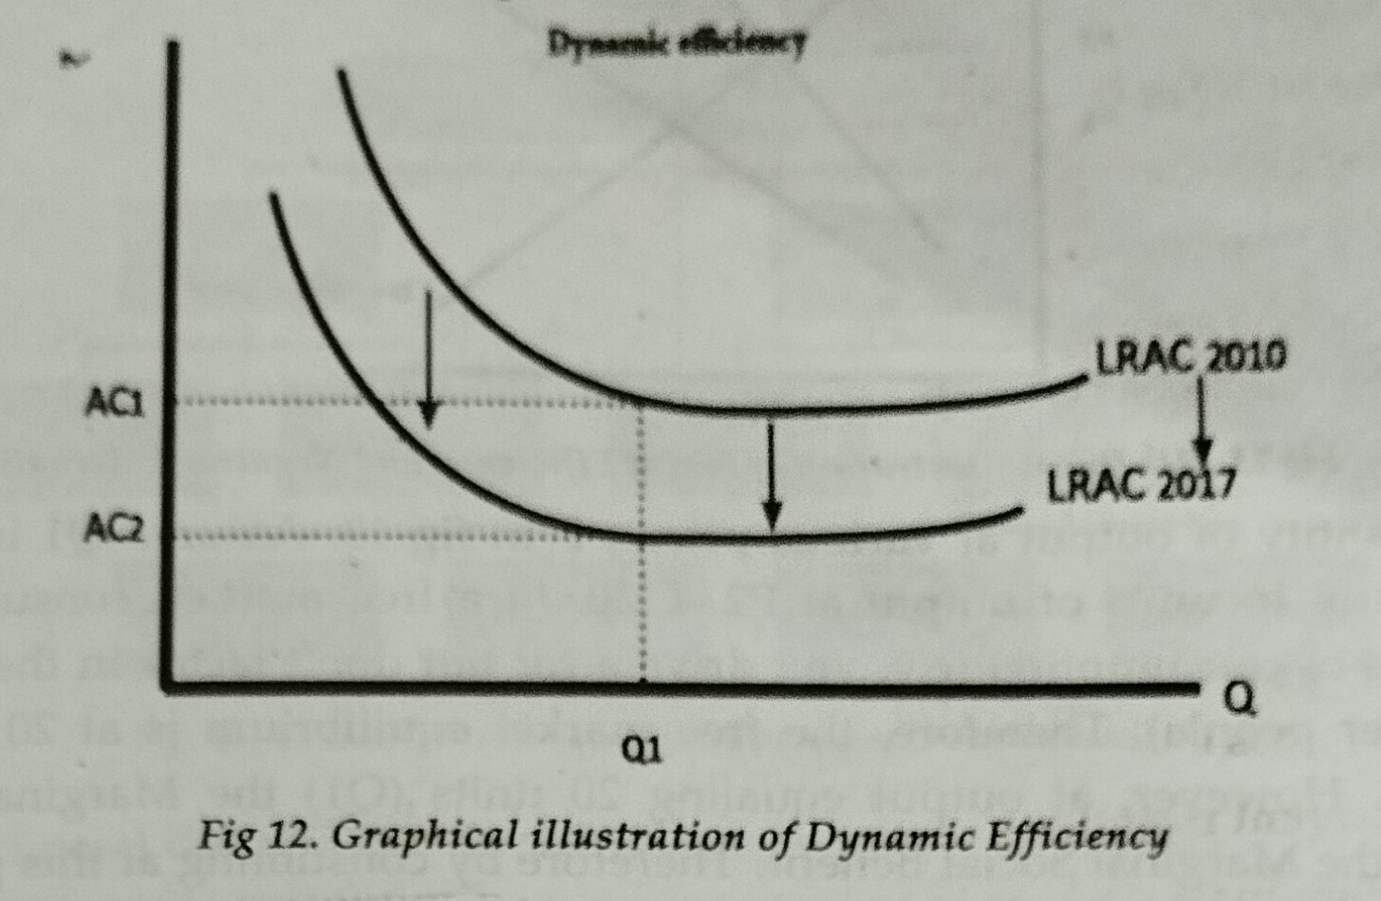
6. Dynamic Efficiency:
This refers to efficiency over time, for example, a factory in 2010 may be inefficient for the time period, but by 2017, it could have gained this relative advantage and by comparison would now be efficient.
It involves the introduction of new technology and working practices to reduce long run average costs over time.

Slide 13
Social Efficiency and Markets

Slide 14
Social Efficiency:
Social efficiency occurs when externalities are taken into consideration and refers to the optimal distribution of resources in the society, taking into account all external costs and benefits as well as the internal costs and benefits.
Social efficiency occurs at an output where the Marginal Social Cost is equal to the Marginal Social Benefit. (MSC=MSB)
The marginal social cost is the cost to society of producing/ consuming one extra unit of output.
Social Benefit = Private benefit + external benefit
Social Cost = Private cost + external cost

Slide 15
Relation between Market and Social efficiency:
The social efficiency affects markets in the form of two externalities:
Negative externality and
Positive externality.
A Negative Externality exists when the production or consumption of a product results in a cost to a third party. Air and noise pollution are commonly cited examples of negative externalities.
A Positive Externality exists if the production and consumption of a good or service benefits a third party not directly involved in the market transaction. For example, education directly benefits the individual and also provides benefits to society as a whole.

Slide 16
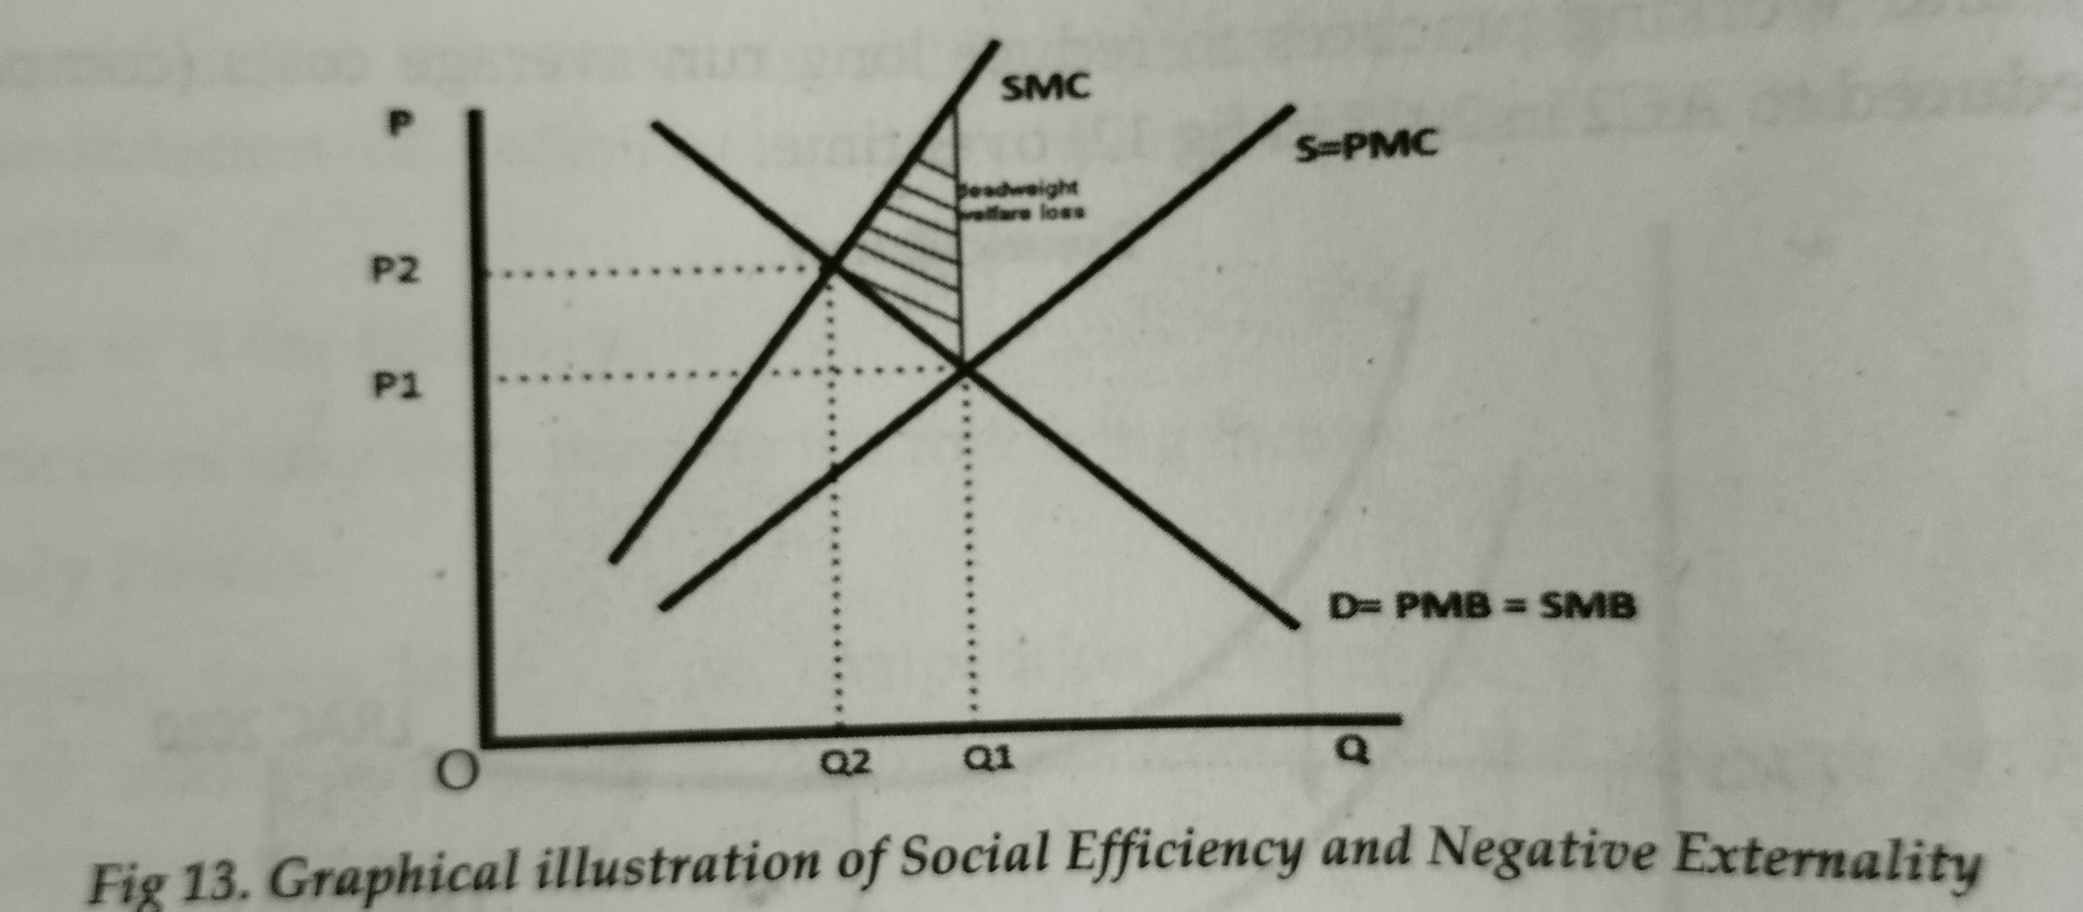
Social efficiency and Negative Externality:
Social efficiency occurs at an output where MSB=MSC. However if a good has a negative externality ignored by individuals, then in a free market we tend to get over-consumption and social inefficiency.

Slide 17
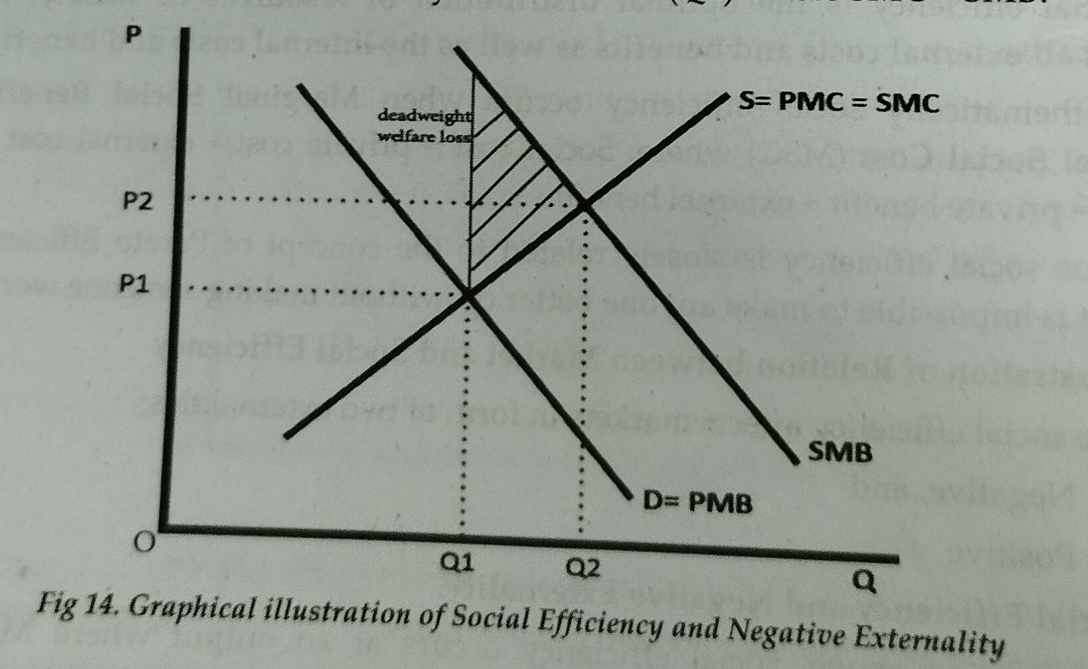
B) Social efficiency and Positive Externality:
With a positive externality, we ignore the benefits to third party. The free market equilibrium is less then the socially efficient level where SMC=SMB.

