Slide 1
Economic Development and Resource Use – Optimist and Pessimist Models’ Major Conclusions

Slide 2
The Pessimist View and Conclusion
According to the resource pessimists, the exponential growth in population will eventually outrun the environment’s ability to provide goods and services. The resources will deplete and environmental degradation will reduce the size of human population and lower its standard of living.
The study was made in the year 1972 and the major conclusion was that the size of population and economic well being would increase until 2000 and after that both population and standard of living would decline along with life expectancy.
Too many people will demand too many resources and will generate too much pollution.

Slide 3
As a solution, the pessimists noted that people realize the importance of protecting the environment and start acting upon it by using better technology, improved energy efficiency, reduce population growth in the nation and follow a social policy to control ozone depletion.

Slide 4
The Optimist view and conclusion
The resource optimist do agree with the pessimist that environmental problems do exists. But they disagree with resource pessimists about their severity.
Optimists accept that population grows exponentially but they disagree that it will be insufficient to meet the requirements of this growing population.
According to them human knowledge and technical capabilities also grow exponentially.
They believe that with human knowledge and technical advancement production of goods and services will also increase.

Slide 5
In order to cater to the increasing demand for natural resources and control discharge of wastages improved technology for discovering and extracting natural resources will be developed.
Substitutes will be developed for the use of scarce natural resources.
Wastages will be controlled.
Environmental clean ups will be undertaken.
In this way the growing population will easily suffice itself.

Slide 6
Sustainable development

Slide 7
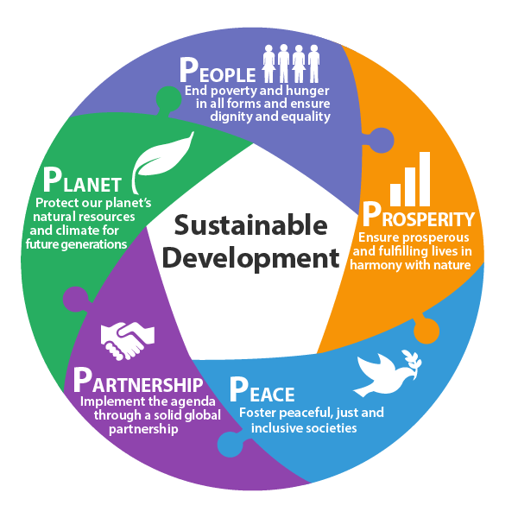

Slide 8
The term “Sustainable Development” got importance after it was used by Brundtland Commission in 1987 in its report “Our Common Future”.
Sustainable development is an action plan for people to use resources without the resources being run out.
This means meet the needs of the present without compromising the ability of the future generations to meet their own needs.
It is a process wherein resource use continue to meet human needs without affecting the integrity, stability and beauty of natural biotic system.
An unsustainable situation occurs when nature’s resources are used up faster than it can be replenished which leads to degradation of the nature.

